Slide 1




HACK HIVE 2025
ROUND-1 PRESENTATION
By – Zero Trust Squad

Slide 2

Simple Password Cracking
Team Name: Zero Trust Squad
PS-ID: HK0002
Title : Simple Password Cracking
Team Members' Names & Contact Info :
T1 : Vivek Jangid , +91 9929394271
T2 : Subham Bharti, +91 9093360932
T3 : Avinash Kushwaha, +91 9140229662

Slide 3
Problem Statement & Solution Recap
Objective: Create a basic password hashing and cracking tool using SHA-256 encryption algorithm.
Approach:
1️⃣ Password Hashing → Convert a user-given password into SHA 256 hash.
2️⃣ Dictionary Attack → Compare a converted hash with a wordlist of possible passwords.(you can customized your own wordlist).
3️⃣ Cracking Process → If a match is found, the password is cracked.

Slide 4

SOLUTION OVERVIEW
How It Works?
Problem: Simple Password Cracking:-
• Weak passwords are vulnerable to dictionary attacks & brute force attacks.
•- Hashing without salting makes passwords easier to crack.
Solution:-
•- Implement SHA-256 hashing with salting to prevent dictionary attacks.
•- Securely store passwords to enhance authentication security.

Slide 5
Technology Stack
Technologies & Frameworks Used:
•- HTML & CSS – UI design for user interaction.
• JavaScript (Web Crypto API) – Handles password hashing with
SHA- 256.
• File Reader API – Reads wordlist files for cracking attempts.
Why These Technologies?
•- Fast & Secure: SHA-256 ensures strong encryption.
• User-Friendly: HTML & CSS provide an intuitive interface.

Slide 6

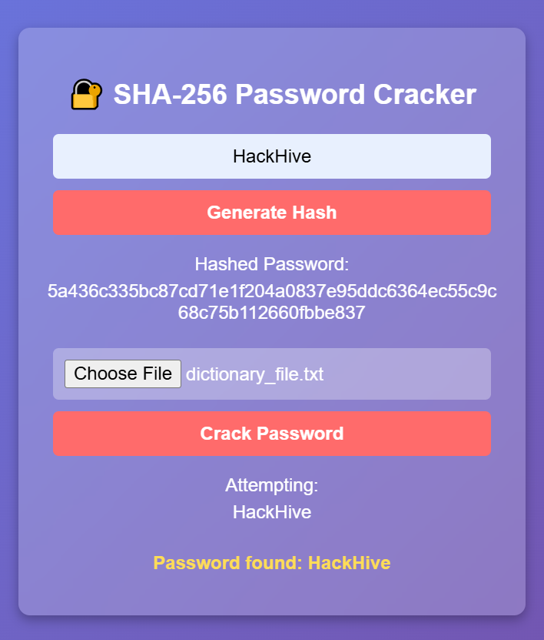
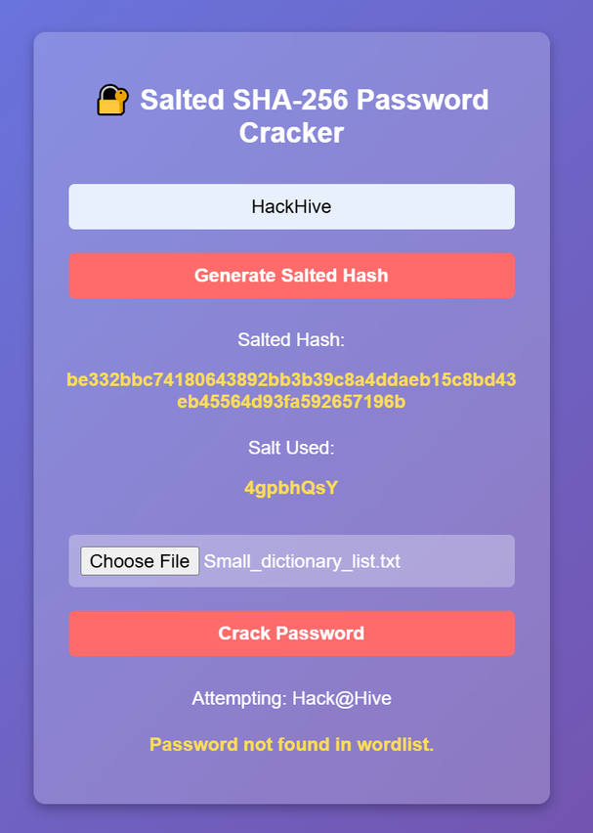
Prototype

Slide 7
Functionality & Implementation
Key Features:
•- SHA-256 hashing with a random salt per password.
•- Custom Wordlist attack simulation to demonstrate password cracking.
•- Proof of salting to show why it's effective.
How It Works (Workflow):
1. User enters a password.
2. A random salt is generated.
3. The password + salt is hashed using SHA-256.
4. The hash & salt are used for Decryption.
5. During cracking attempts, the system compares hashed values.

Slide 8
Impact & Benefits
Who Benefits?
•- Websites & applications handling user authentication.
•- Individuals securing their accounts.
•- Security researchers & developers learning about password security.
Real-World Impact:
•- Reduces risk of password leaks & brute-force attacks.
•- Makes dictionary attacks ineffective due to unique salts.

Slide 9
Challenges & Learnings
Challenges Faced:
•- Generating & storing unique salts securely.
•- Optimizing the hashing process for performance.
How We Overcame Them:
•- Implemented secure random salt generation.
•- Used efficient hashing functions in Java Script.

Slide 10
Future Scope & Enhancements
• Possible Improvements:
•- Implementing bcrypt for even stronger hashing.
•- Adding multi-factor authentication (MFA).
•- Real-time password strength analysis.

Slide 11
Conclusion & Acknowledgment
Summary:
•- Our project demonstrates the importance of secure password storage using SHA-256 hashing with salting.
Thanks to School of Computer Application and JU CyberNetCams for Organizing this great event

Slide 12



